Slide 1
Safety Presentation
By Amritpal Kaur Sandhu

Slide 2
Workplace Scene to Identify Hazards:

Slide 3

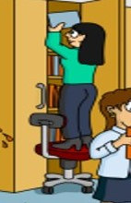
Hazard 1: Using wrong equipment
Hazard: A worker is standing on office chair to take files from cupboard. The chair has wheels so can move around.
Risk: Worker may have fall and serious injury.
Risk Controls: She must use ladder instead office chair.
Consultation with peers: Employer must provide training to workers to use right equipment.

Slide 4

Hazard 2: Inappropriate Behavior at workplace
Hazard: A worker, sitting inappropriately in his cabin, is passing the stapler by throwing it to other worker.
Risk: Stapler can cause serious injury if hit on her head or face and can also damage the property.
Risk Controls: Worker must behave professionally, follow the instructions and use right way to do things such as pass the stapler to her hand.
Consultation with peers: Employer must provide training to workers about behavior at workplace.

Slide 5
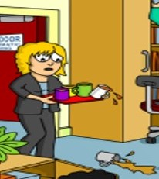
Hazard 3: Manage the tasks
Hazard: A worker is walking with a tray with coffee cups, one cup is fell down and second cup is falling as it is on the edge of the tray. Tray does not has any edge support.
Risk: Worker may have fall by slipping on coffee that can result into serious injury.
Risk Controls: She must use trolley to reduce the potential of the risk.
Consultation with peers: She can also use appropriate tray or ask other staff to help her.

Slide 6
Consultation and it’s importance
Consultation is the way of discussing the problems, solutions, decisions, suggestions and other important matters among employer and employees to maintain the health and safety of a workplace
Importance of Consultation:
With the cooperation and collaboration of staff, workplace becomes more productive.
It helps in making positive cultural changes in workplace.
It brings equality in workers.
It comes with greater awareness and commitment.

Slide 7
First-Aid Training Option Table
Name of Provider | Name of Course | Course Fee | Course Topics | Course Refresher Fee
Safe Place Training | First-Aid Training | $90 | HLTAID003 Provide First Aid, HLTAID002 Provide Basic Emergency Life Support and HLTAID001 Provide Cardiopulmonary Resuscitation (CPR) | $90
Red Cross Training services | First-Aid Training | $155 | HLTAID003 Provide First Aid, Basic Life Support, CPR and Automated External Defibrillator (AED). | $85
AUS Compliance Training | First-Aid Training | $135 | HLTAID003 Provider First Aid, CPR and Basic Life Support (D-R-S-A-B-C-D) | $105

Slide 8
This Photo by Unknown Author is licensed under CC BY

